Slide 1
Power electronic and drives: ELEC 2208 – 1
Chapter 1: Electromagnetic and Mechanical Fundamentals
Dr Frederic Gardes
University of Southampton

Slide 2
Electric motor drives – what are the applications?
Hard Drive
https://www.youtube.com/watch?v=J6VQGveQXNo
Milling and Turning (lathe)
https://www.youtube.com/watch?v=0PDJQGvQLaU
Cement plant
https://www.youtube.com/watch?v=YFp8OYZpnfc
https://www.youtube.com/watch?v=1FY_YkOaXOM
Ship’s electric propulsion
https://www.youtube.com/watch?v=dv4C_LdoDaE
More Electric Aircraft
https://www.youtube.com/watch?v=h8g5G1buNIM

Slide 3
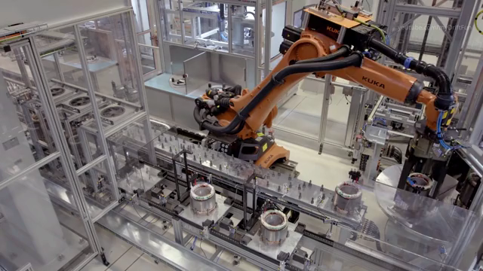
Electric motor drives – what are the applications?
Electric motors for:
Displacement (robot on rails)
Rotational movements (rotating arm)
Taking and holding objects
And much more…
Design of Electric motor drives considering:
Displacement
Speed
Acceleration
Inertia
Friction
Energy
Torque
Etc.
https://gfycat.com/grayanimatedblesbok

Slide 4
Overview
Chapter 1 covers the following basic definitions:
Moment of inertia
Friction
Path control
Power transmission
Torque balanced equation and kinetic energy
Torque and kinetic energy
Examples of connectors
Transducers

Slide 5
Moment of inertia

Slide 6
The moment of inertia is a characteristic of an object to resist
Join: vevox.app ID: 140-740-781
POLL OPEN
1.
Rotational acceleration
0%
2.
Linear acceleration
0%
3.
Linear Translation
0%
4.
Internal forces
0%
Vote Trigger

Slide 7
If an object is only translating linearly, you don’t need to concern yourself with its mass moment of inertia
Join: vevox.app ID: 140-740-781
POLL OPEN
1.
True
0%
2.
False
0%
Vote Trigger

Slide 8
Which of the following is an example of units used to describe mass moment of inertia, J?
Join: vevox.app ID: 140-740-781
POLL OPEN
1.
kg•m2
0%
2.
m•s2
0%
3.
N.m
0%
4.
Joules
0%
Vote Trigger

Slide 9
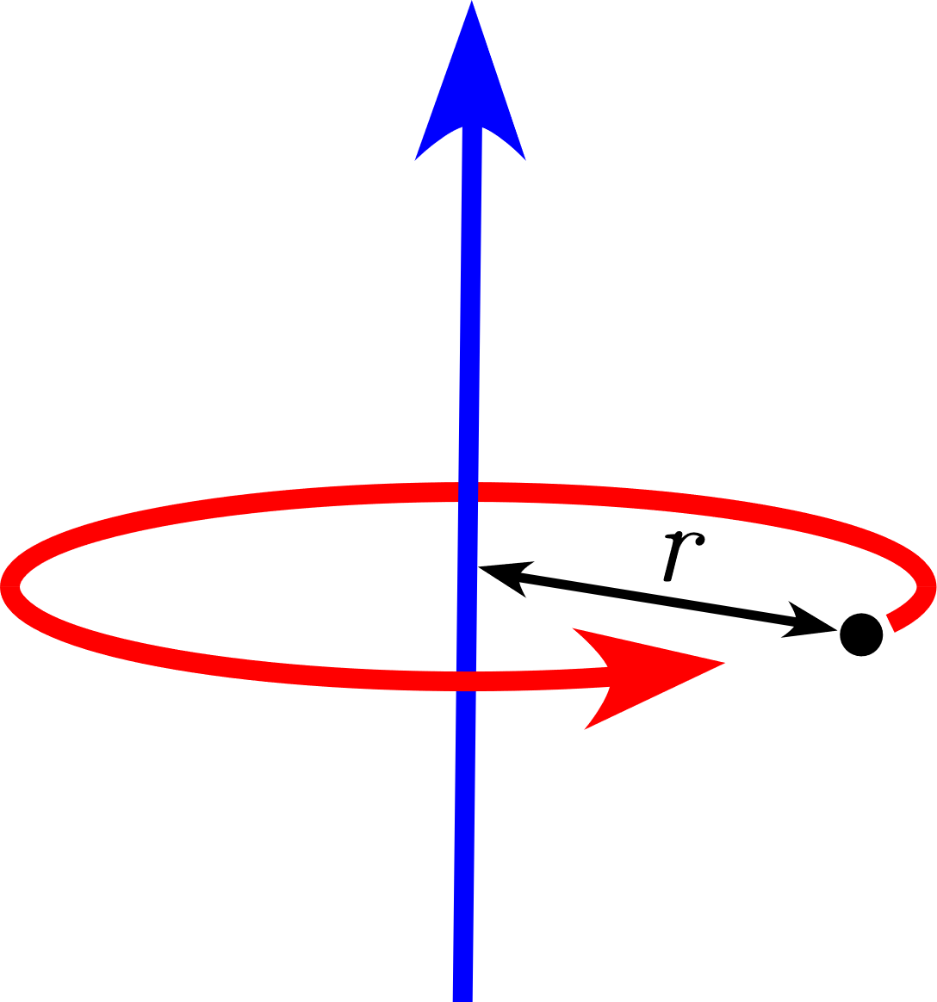
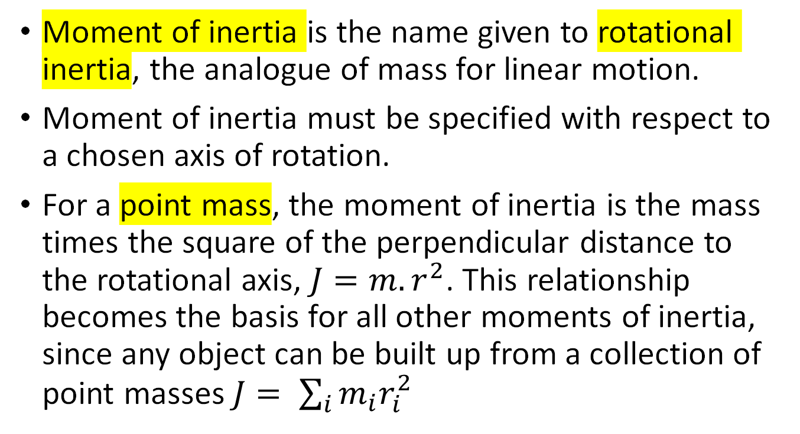

Mechanics in Drive System
Moment of inertia
Moment of inertia is the name given to rotational inertia, the analogue of mass for linear motion.
Moment of inertia must be specified with respect to a chosen axis of rotation.
For a point mass, the moment of inertia is the mass times the square of the perpendicular distance to the rotational axis, $J=m{.r}^{2}$. This relationship becomes the basis for all other moments of inertia, since any object can be built up from a collection of point masses $J= \sum_{i}{m_{i}r_{i}^{2}}$
$$m$$

Slide 10
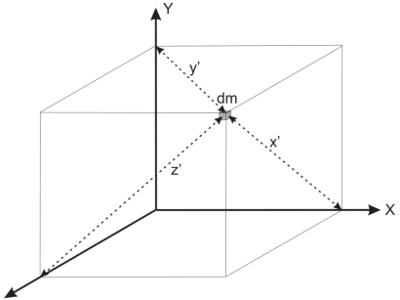
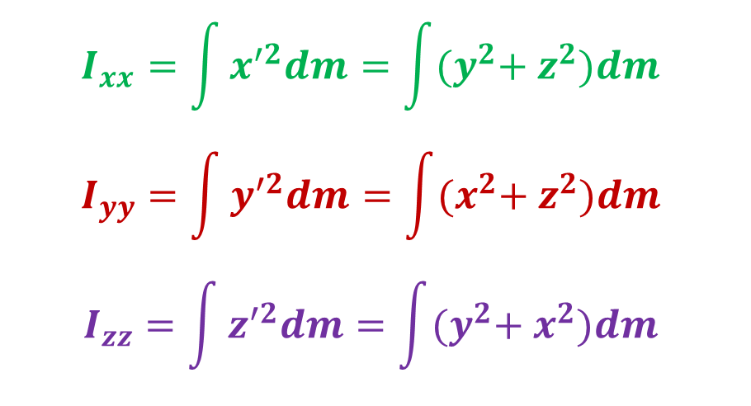

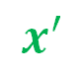
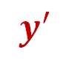
Moment of inertia
Moment of inertia, or rotational inertia is defined as the mass x perpendicular distance squared (I = mr²). Mass and moment of inertia of non-point mass object is obtained by integration.
Y
$$I_{xx}=\int{x^{′2}dm}=\int{{(y}^{2}+ z^{2})dm }$$
$$I_{yy}=\int{y^{′2}dm}=\int{{(x}^{2}+ z^{2})dm }$$
$$I_{zz}=\int{z^{′2}dm}=\int{{(y}^{2}+ x^{2})dm }$$
$$y′$$
$$x′$$
$$z′$$
X
y
z
Z

Slide 11

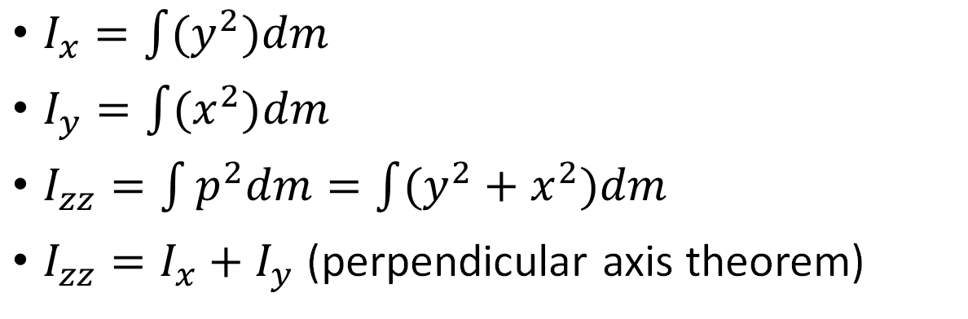
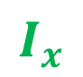

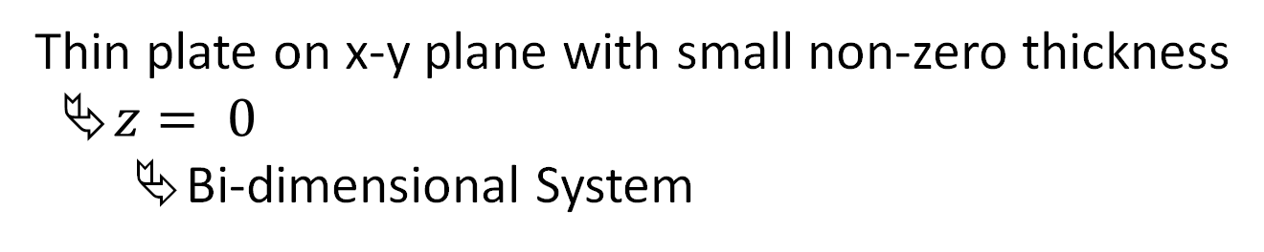
Inertia on the XY-plane
Thin plate on x-y plane with small non-zero thickness
$z= 0$
Bi-dimensional System
$$I_{y}$$
$I_{x}=\int{{(y}^{2})dm }$
$I_{y}=\int{{(x}^{2})dm }$
$I_{zz}=\int{p^{2}dm=\int{(y^{2}+x^{2})dm }}$
$I_{zz}=I_{x}+I_{y}$ (perpendicular axis theorem)
$$I_{z}$$
$$I_{x}$$

Slide 12
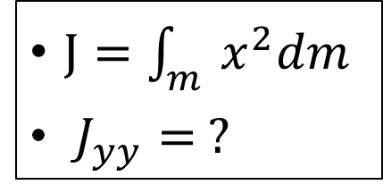
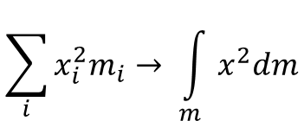
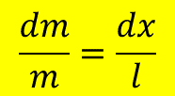
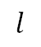
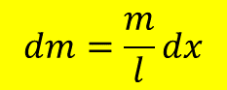
Mechanics in Drive System
Moment of Inertia - Bar
$$\sum_{i}{x_{i}^{2}m_{i}}→ \int_{m}{x^{2}dm}$$
Mass evenly distributed on the object
x₁
x₂
dm
$$\frac{dm}{m}=\frac{dx}{l}$$
…
$$dm=\frac{m}{l}dx$$
x_{i}
dm
$$l$$
$$l$$
$J=\int_{m}{x^{2}dm}$
$J_{yy}= ?$

Slide 13
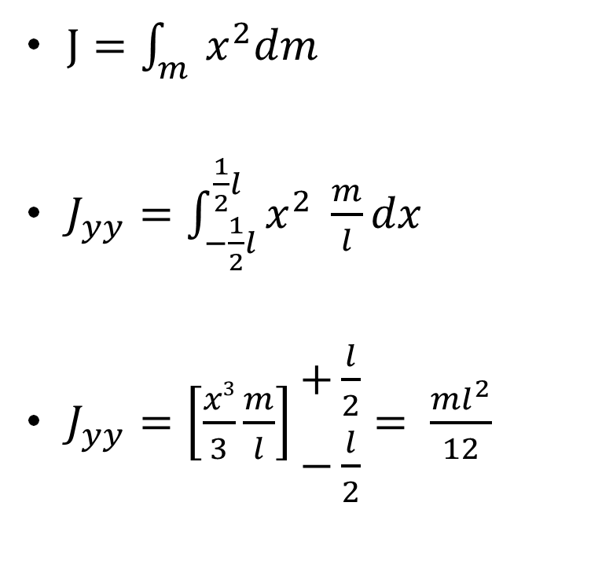
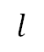
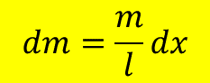
Mechanics in Drive System
Moment of Inertia - Bar
$J=\int_{m}{x^{2}dm}$
$J_{yy}=\int_{−\frac{1}{2}l}^{\frac{1}{2}l}{x^{2} \frac{m}{l}dx}$
$J_{yy}=\left[\frac{x3}{3}\frac{m}{l}\right]\begin{matrix}+\frac{l}{2} \\ −\frac{l}{2}\end{matrix}= \frac{{ml}^{2}}{12}$
x
$$dm=\frac{m}{l}dx$$
$$l$$
$$l$$

Slide 14
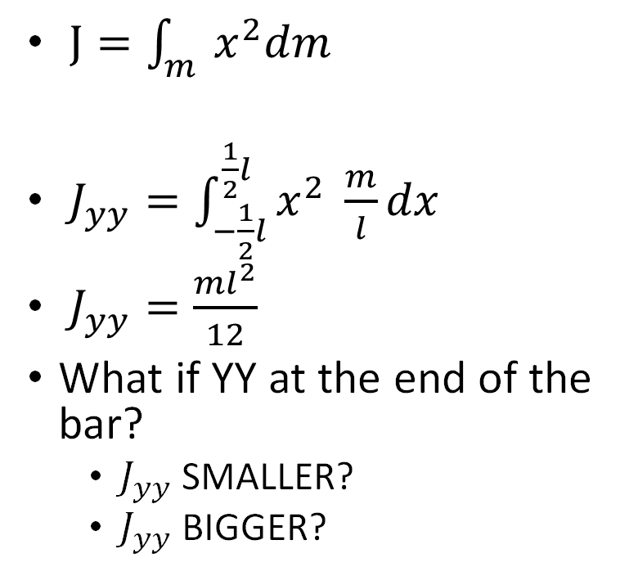
Mechanics in Drive System
Moment of Inertia - Bar
Y
Y
$J=\int_{m}{x^{2}dm}$
$J_{yy}=\int_{−\frac{1}{2}l}^{\frac{1}{2}l}{x^{2} \frac{m}{l}dx}$
$J_{yy}=\frac{{ml}^{2}}{12}$
What if YY at the end of the bar?
$J_{yy}$ SMALLER?
$J_{yy}$ BIGGER?
$$dm=\frac{m}{l}dx$$
$$l$$
$$l$$

Slide 15
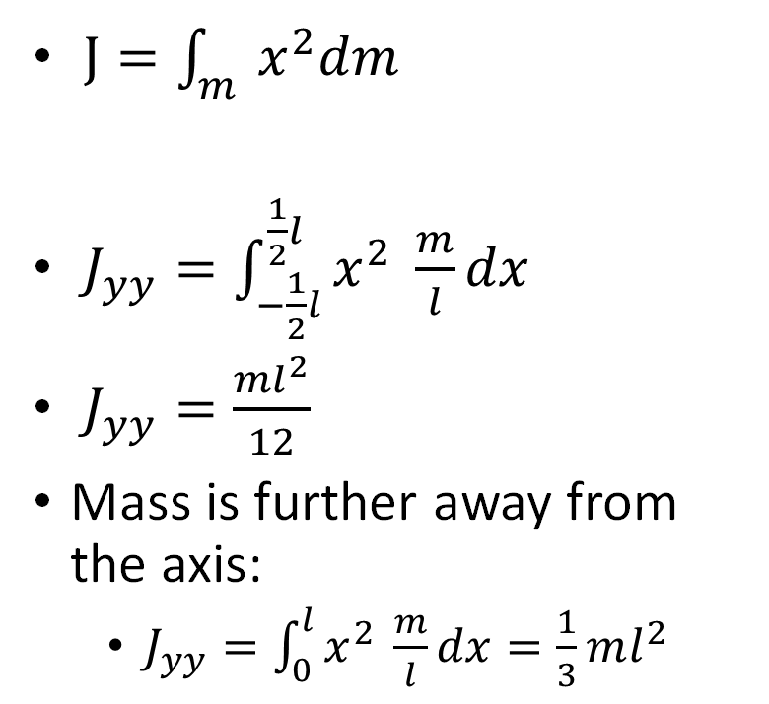
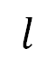
Mechanics in Drive System
Moment of Inertia - Bar
Y
Y
$J=\int_{m}{x^{2}dm}$
$J_{yy}=\int_{−\frac{1}{2}l}^{\frac{1}{2}l}{x^{2} \frac{m}{l}dx}$
$J_{yy}=\frac{{ml}^{2}}{12}$
Mass is further away from the axis:
$J_{yy}=\int_{0}^{l}{x^{2} \frac{m}{l}dx=\frac{1}{3}ml^{2}}$
x
$$dm=\frac{m}{l}dx$$
dm
$$l$$

Slide 16
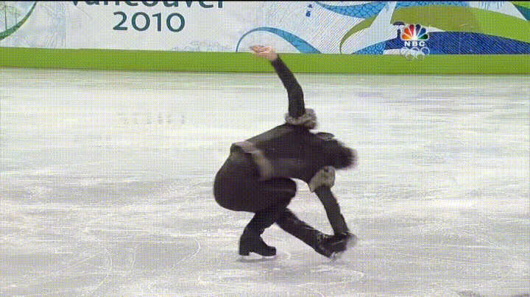
Conservation of the angular momentum
Limbs far from the rotational axis
Bigger Moment of Inertia
Smaller angular speed
Limbs close to the rotational axis
Smaller Moment of Inertia
Bigger angular speed

Slide 17
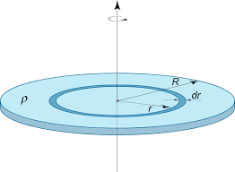
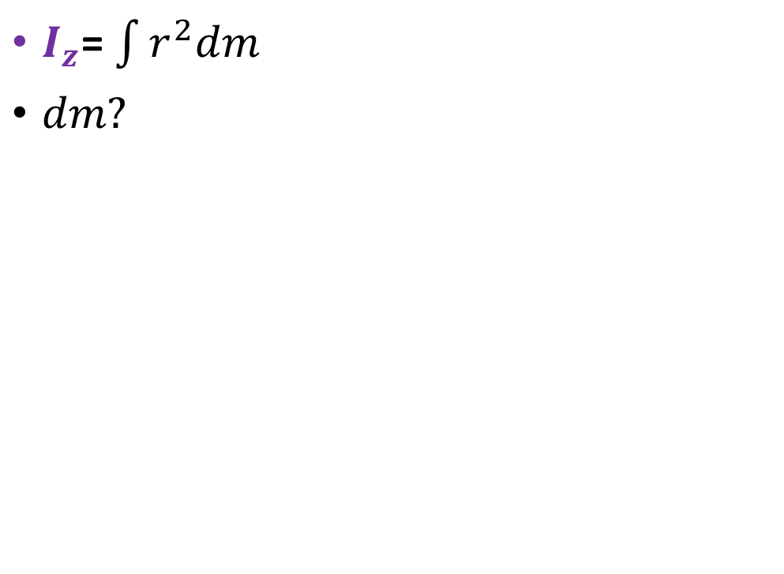
Mechanics in Drive System
Moment of Inertia - Thin disk
$I_{z}$= $\int{r^{2}dm}$
$dm?$

Slide 18
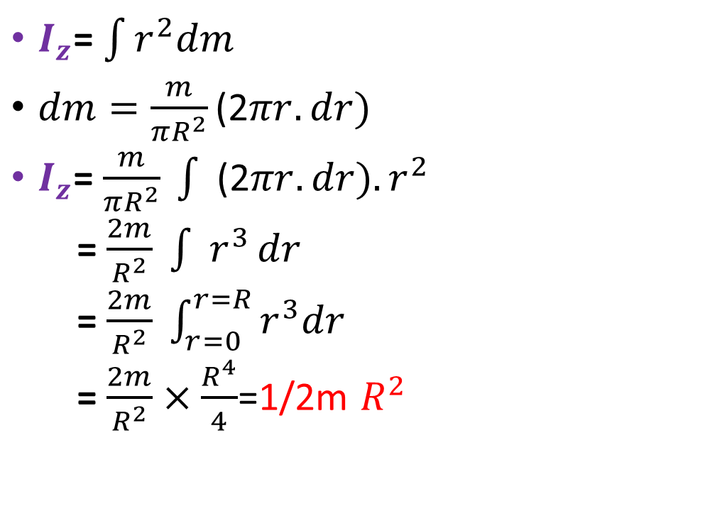
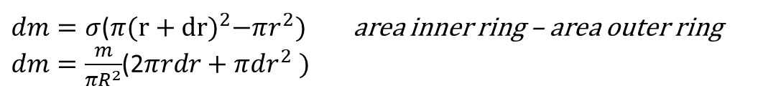
Mechanics in Drive System
Moment of Inertia - Thin disk
$I_{z}$= $\int{r^{2}dm}$
$dm=\frac{m}{πR^{2}}\text{(2}πr.dr)$
$I_{z}$= $\frac{m}{πR^{2}} \int{ \text{(2}πr.dr){.r}^{2}}$
= $\frac{2m}{R^{2}} \int{ r^{3}}dr$
= $\frac{2m}{R^{2}} \int_{r=0}^{r=R}{r^{3}dr}$
= $\frac{2m}{R^{2}}×\frac{R^{4}}{4}$=1/2m $R^{2}$
$Unit mass σ=\frac{m}{πR^{2}}$ for a uniform thin disc
$dm=σ$($π{(r+dr)}^{2}−πr^{2})$ area inner ring – area outer ring
$dm=\frac{m}{πR^{2}}$(2$πrdr+πdr^{2} )$
$limit dr →0 then πdr^{2}$ $→0$ faster than 2$πrdr$
$therefore simplify to dm=\frac{m}{πR^{2}}$(2$πr.dr)$

Slide 19
Other common bodies

Slide 20
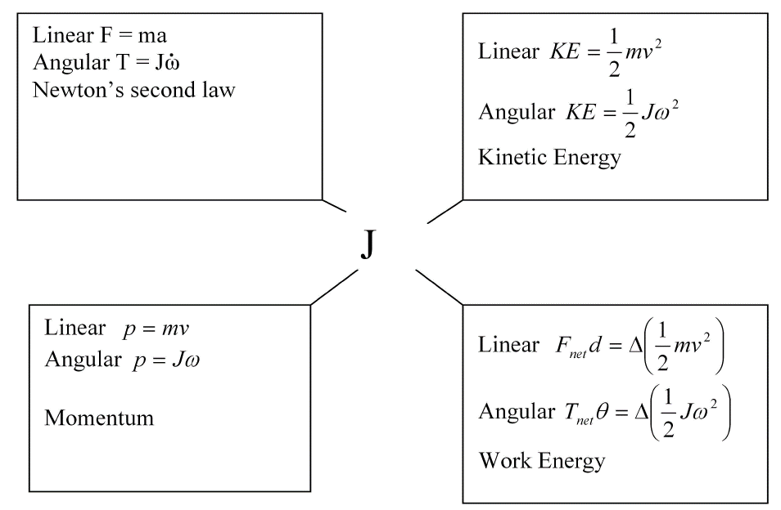
Mechanics in Drive System
Equivalents for Moment of Inertia
derivative

Slide 21
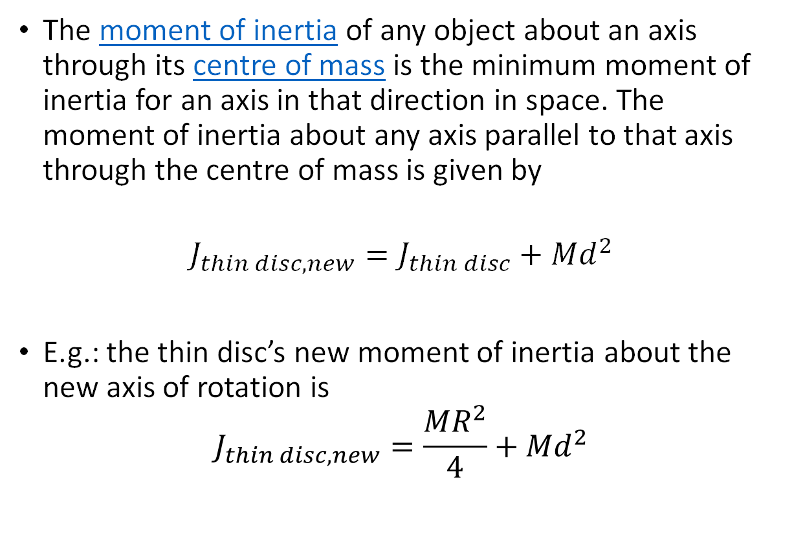
Moment of inertia
The moment of inertia of any object about an axis through its centre of mass is the minimum moment of inertia for an axis in that direction in space. The moment of inertia about any axis parallel to that axis through the centre of mass is given by
$$J_{thin disc,new}=J_{thin disc}+{Md}^{2}$$
E.g.: the thin disc’s new moment of inertia about the new axis of rotation is
$$J_{thin disc,new}=\frac{{MR}^{2}}{4}+{Md}^{2}$$
Mass M
2R
Axis through centre of mass

Slide 22
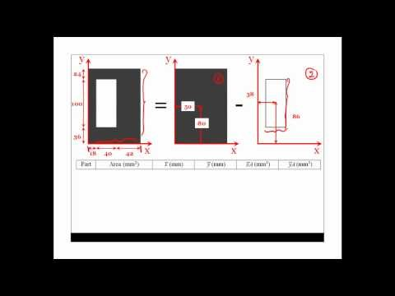
Inertia calculation example

Slide 23
Friction

Slide 24
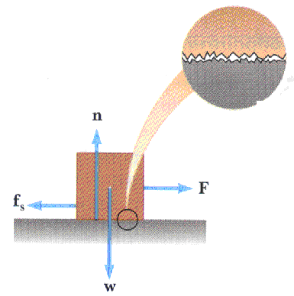
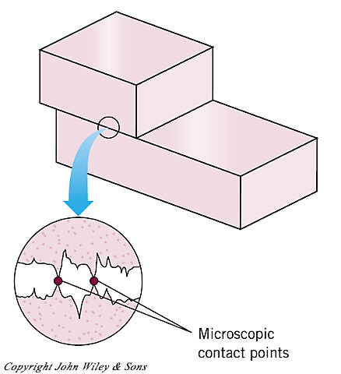
Friction depends on:
The type of surfaces (u) “mu” - coefficient of friction
How hard the surfaces are pressed together (F_{N} ) – Normal force

Slide 25
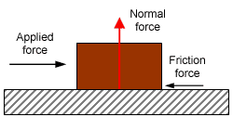
Friction forces
Friction always opposes motion.
The applied force must be greater than the static frictional force to move the block.

Slide 26
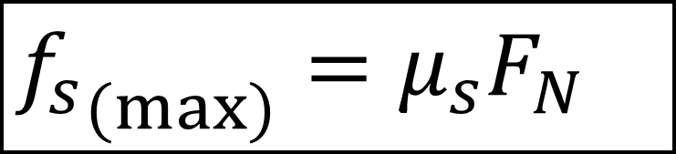
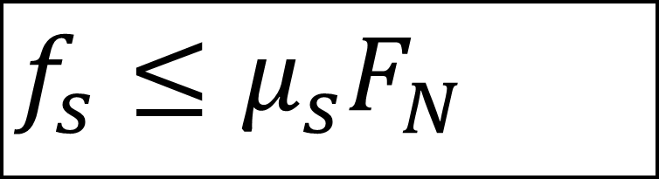
$$f_{s}≤μ_{s}F_{N}$$
Static friction
static frictional force
Normal force
“Mu” coefficient of static friction
$${f_{s}}_{(\max{)}}=μ_{s}F_{N}$$
maximum force of static friction
f_{s max} is the force you must exceed to move the object.

Slide 27
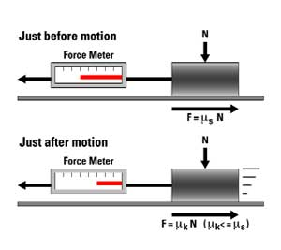
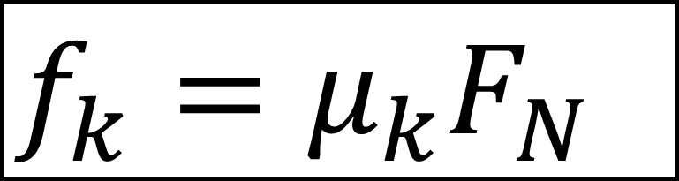
Dynamic friction
$$f_{k}=μ_{k}F_{N}$$
Kinetic frictional force
“Mu” coefficient of Kinetic friction
Normal force
Once object moves.
Use μ_{k}
f_{k} is constant
There is no “maximum f_{k}.”

Slide 28
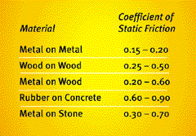
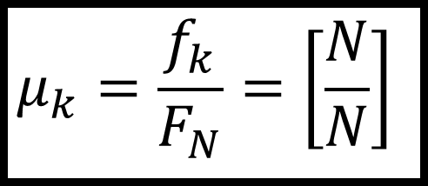
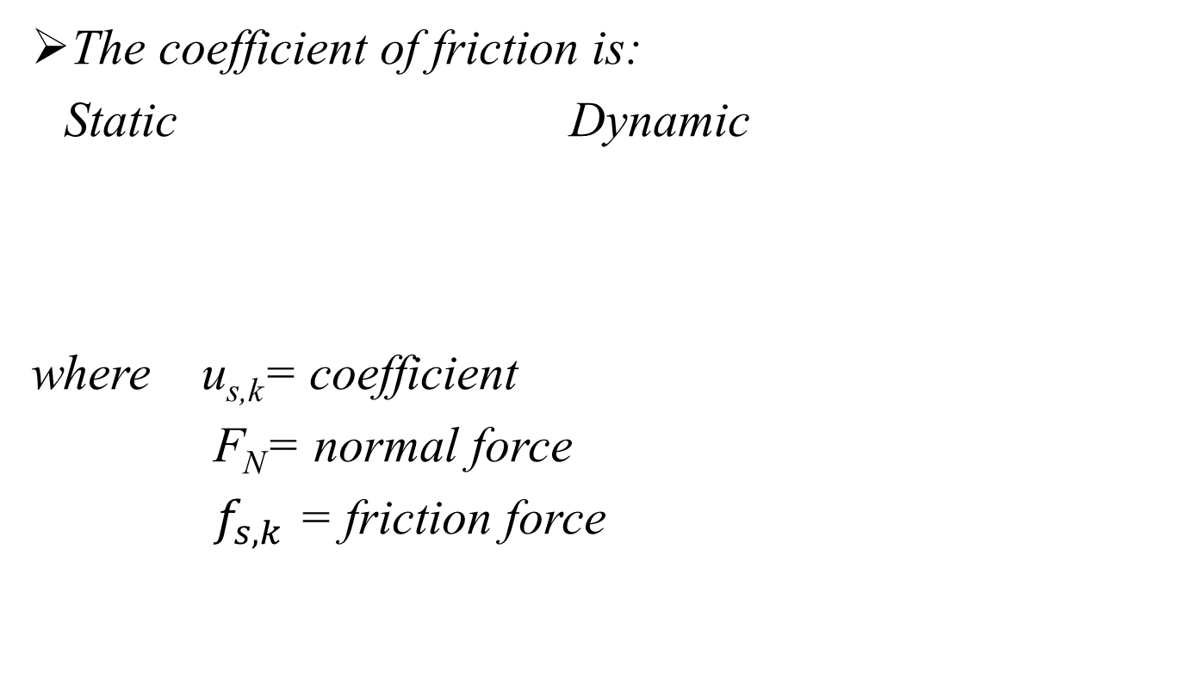
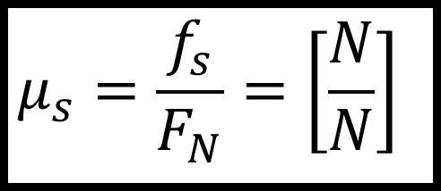
The coefficient of friction is:
Static Dynamic
where u_{s,k}= coefficient
F_{N}= normal force
$f_{s,k}$ = friction force
$$μ_{s}=\frac{f_{s}}{F_{N}}=\left[\frac{N}{N}\right]$$
$$μ_{k}=\frac{f_{k}}{F_{N}}=\left[\frac{N}{N}\right]$$
The coefficient of friction is dimensionless – no units.
The greater the u_{s} the more force needed to move the object.
The greater the u_{k} the more force needed to keep the object moving.

Slide 29
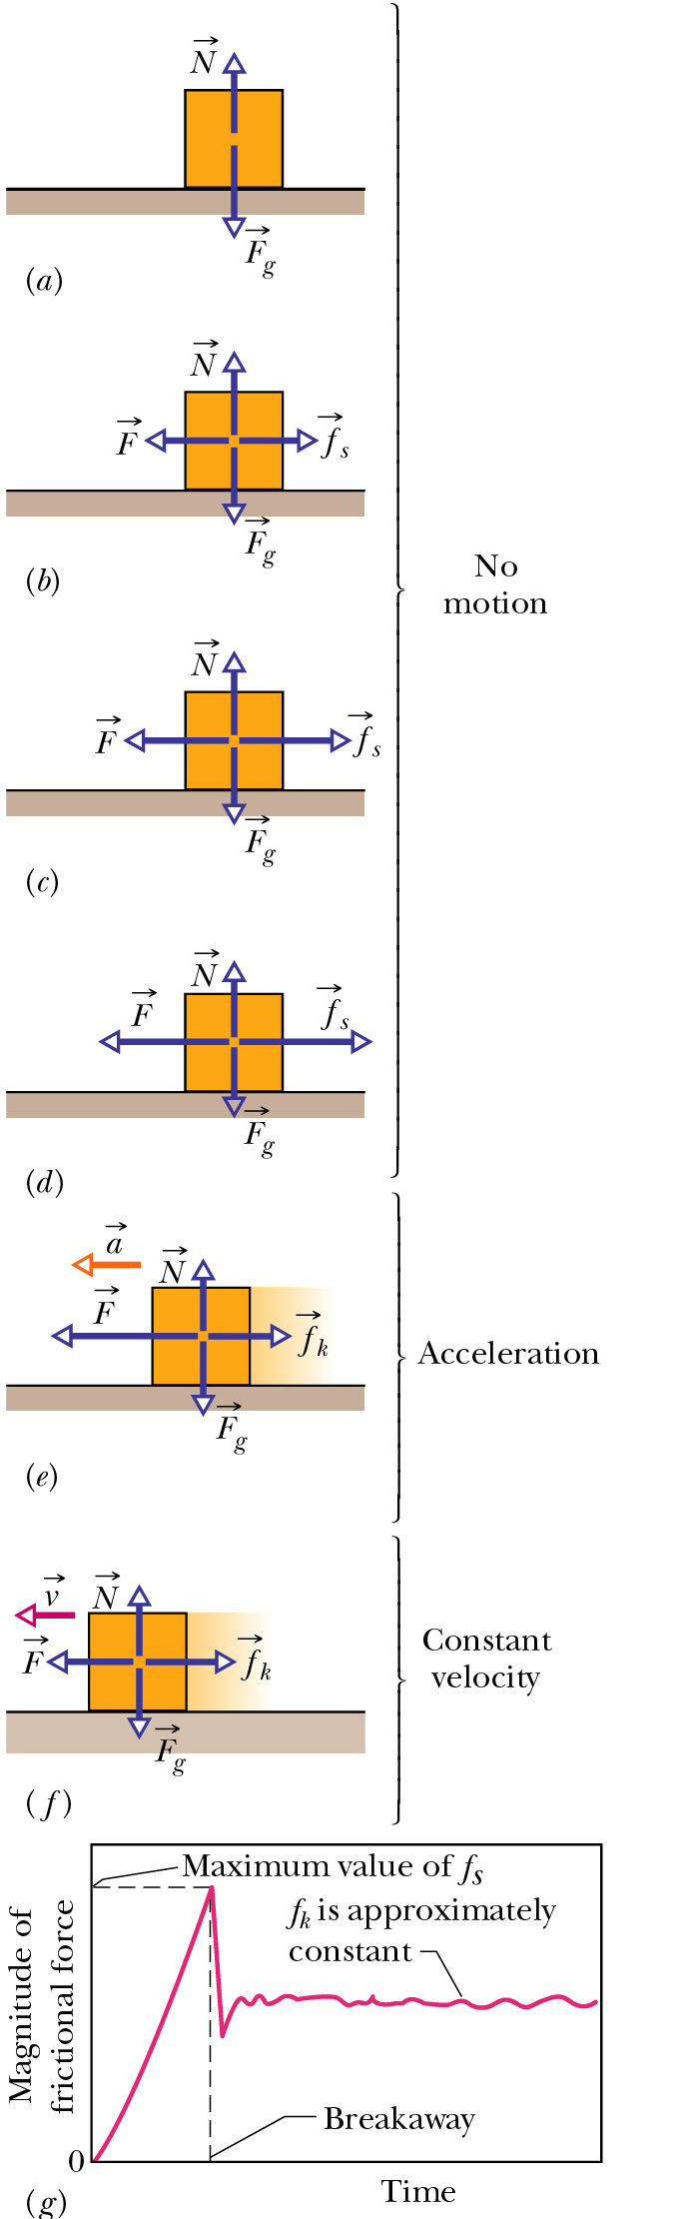
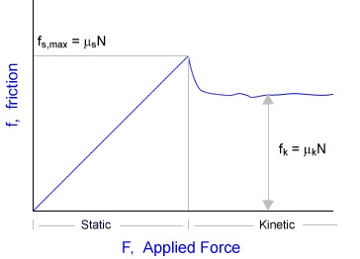
Static friction, f_{s}
Kinetic friction, f_{k}

Slide 30
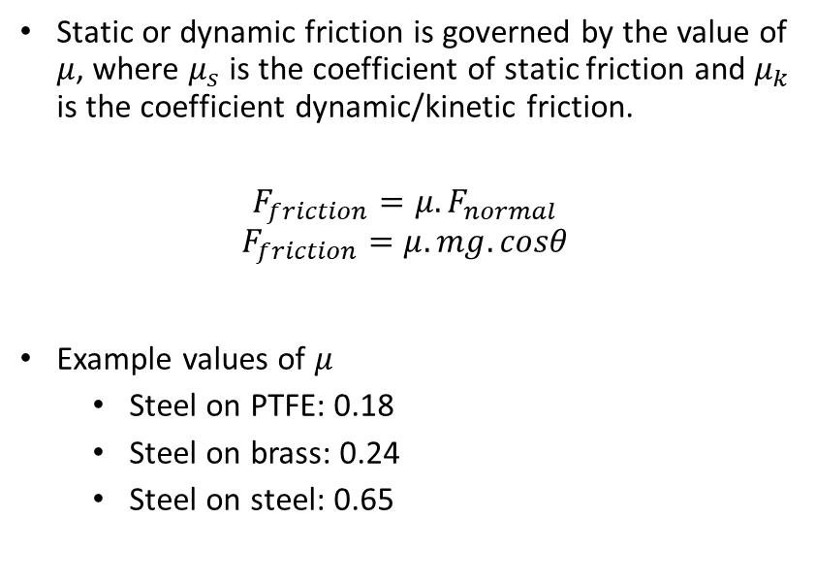
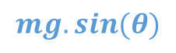

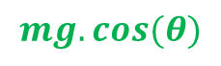
Friction
Static or dynamic friction is governed by the value of $μ$, where $μ_{s}$ is the coefficient of static friction and $μ_{k}$ is the coefficient dynamic/kinetic friction.
$$F_{friction}=μ.F_{normal}$$
$$F_{friction}=μ.mg.cosθ$$
Example values of 𝜇
Steel on PTFE: 0.18
Steel on brass: 0.24
Steel on steel: 0.65
90° rotation
N
θ
θ
$$mg.cos⁡(θ)$$
$$mg$$
θ
$$mg.sin⁡(θ)$$

Slide 31
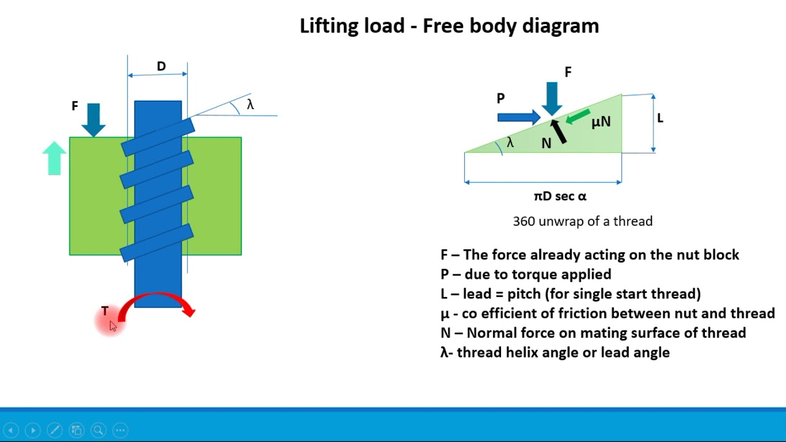
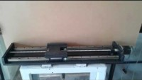
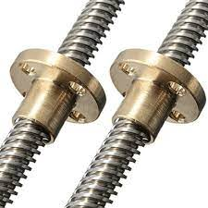

Slide 32
